Slide 1

Toxic comment classification
Instructor –
M. R. Rejati
Developed by –
Siyan Cheng
Laksh Matai
Tong Liu

Slide 2
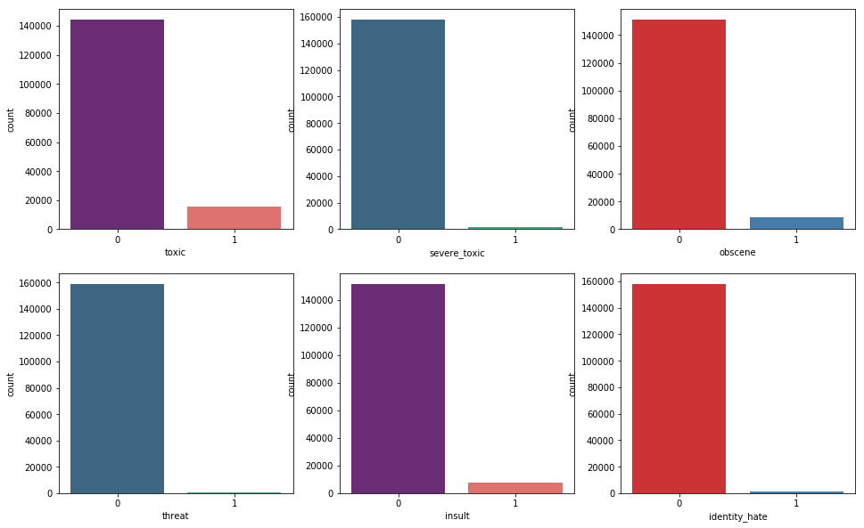
Introduction to problem and dataset
Dataset –
Problem –
To build a multi-headed model that’s capable of detecting different types of of toxicity like threats, obscenity, insults, and identity-based hate.

Slide 3
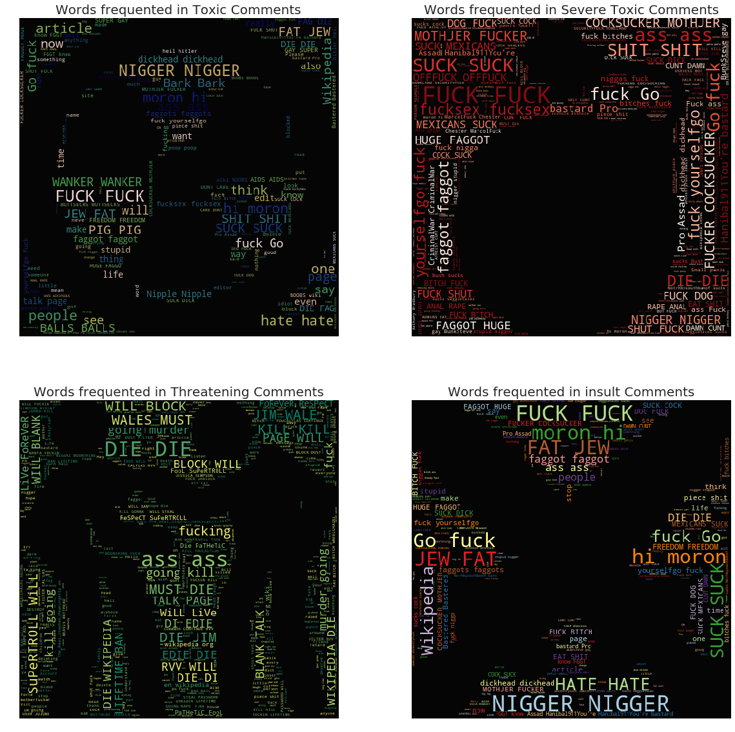
Word Maps for different toxic labels
Image courtesy: Jagan | Kaggle participant

Slide 4
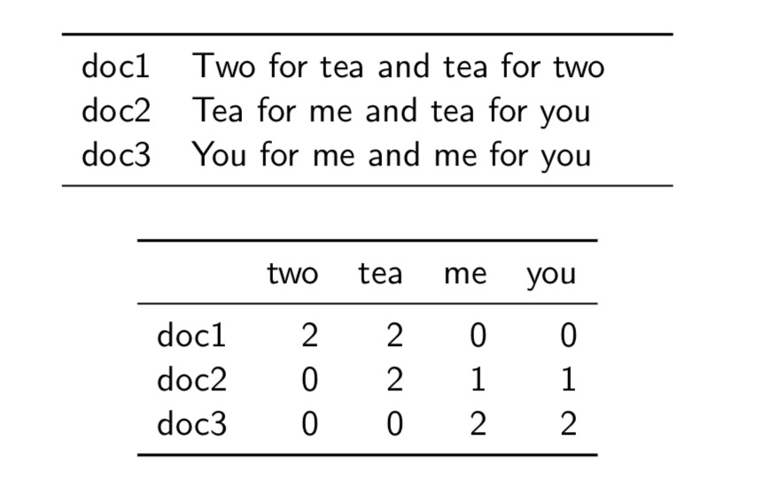
Preprocessing
1. Cleaning data by removing shortcuts
Input – What’s the time right now? | Output – What is the time now?
Remove null values
2. Using TFIDF(Term Frequency Inverse Document Frequency)

Slide 5
Flow Chart
Read
Data
Clean
Data
Tokenize to
TFIDF
Fit
Model
Make
Prediction

Slide 6
paperspace
A fully-managed enterprise GPU cloud platform available on desktops, terminals, and servers.
model | without P4000 GPU | with P4000 GPU
CNN 5-epoch | 4 hours | 5 minutes
LSTM | 6~8 hours | 30 minutes
It is impossible to adjust the hyper-parameters if we just use our CPU on our laptop.

Slide 7
Random Forest
Random forest builds multiple decision trees and merges them together to get a more accurate and stable prediction.
ROC: 0.934
Accuracy: 0.914

Slide 8
LSTM
RNN
Humans don’t start their thinking from scratch every second. As we read this essay, we understand each word based on our understanding of previous words. We don’t throw everything away and start thinking from scratch again. Our thoughts have persistence.
Traditional neural networks can’t do this, but Recurrent Neural Networks address this issue.
Long Short Term Memory (LSTM) networks are a special kind of RNN, capable of learning long-term dependencies.
LSTM

Slide 9
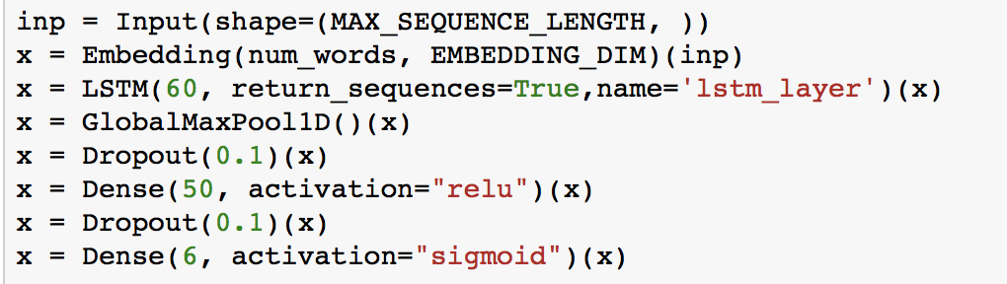
Procedure
Looked up for value of each word in word_index dictionary
Added LSTM layers with 60 states
Flattened the data by taking max value per column, this creates 1 D array of data
1 drop out layer
Added fully connected layer of 50 neurons
1 drop out layer
Added fully connected layer of 6 neurons

Slide 10
Results
LSTM: ROC-AUC - epoch: 4 - score: 0.973148
127657/127657 [==============================] - 383s –
loss: 0.0435 - acc: 0.9839 - val_loss: 0.0509 - val_acc: 0.9815

Slide 11
Logistic regression
Used GridSearchCV to find best C for the model
Performed Multi-Label classification by training model for each label. Created 6 different models for each label.
Predicted each label for different models.
Combined predictions of each label and calculated accuracy
Drew ROC curve for the model.

Slide 12
XGboost
Parameters:
eta [default=0.3, alias: learning_rate]
-- step size shrinkage used in update to prevents overfitting.
max_depth [default=6]
-- maximum depth of a tree
subsample [default=1]
-- subsample ratio of the training instance.
colsample_bytree [default=1]
-- subsample ratio of columns for each split, in each level.
“binary:logistic” – logistic regression for binary classification, output probability

Slide 13
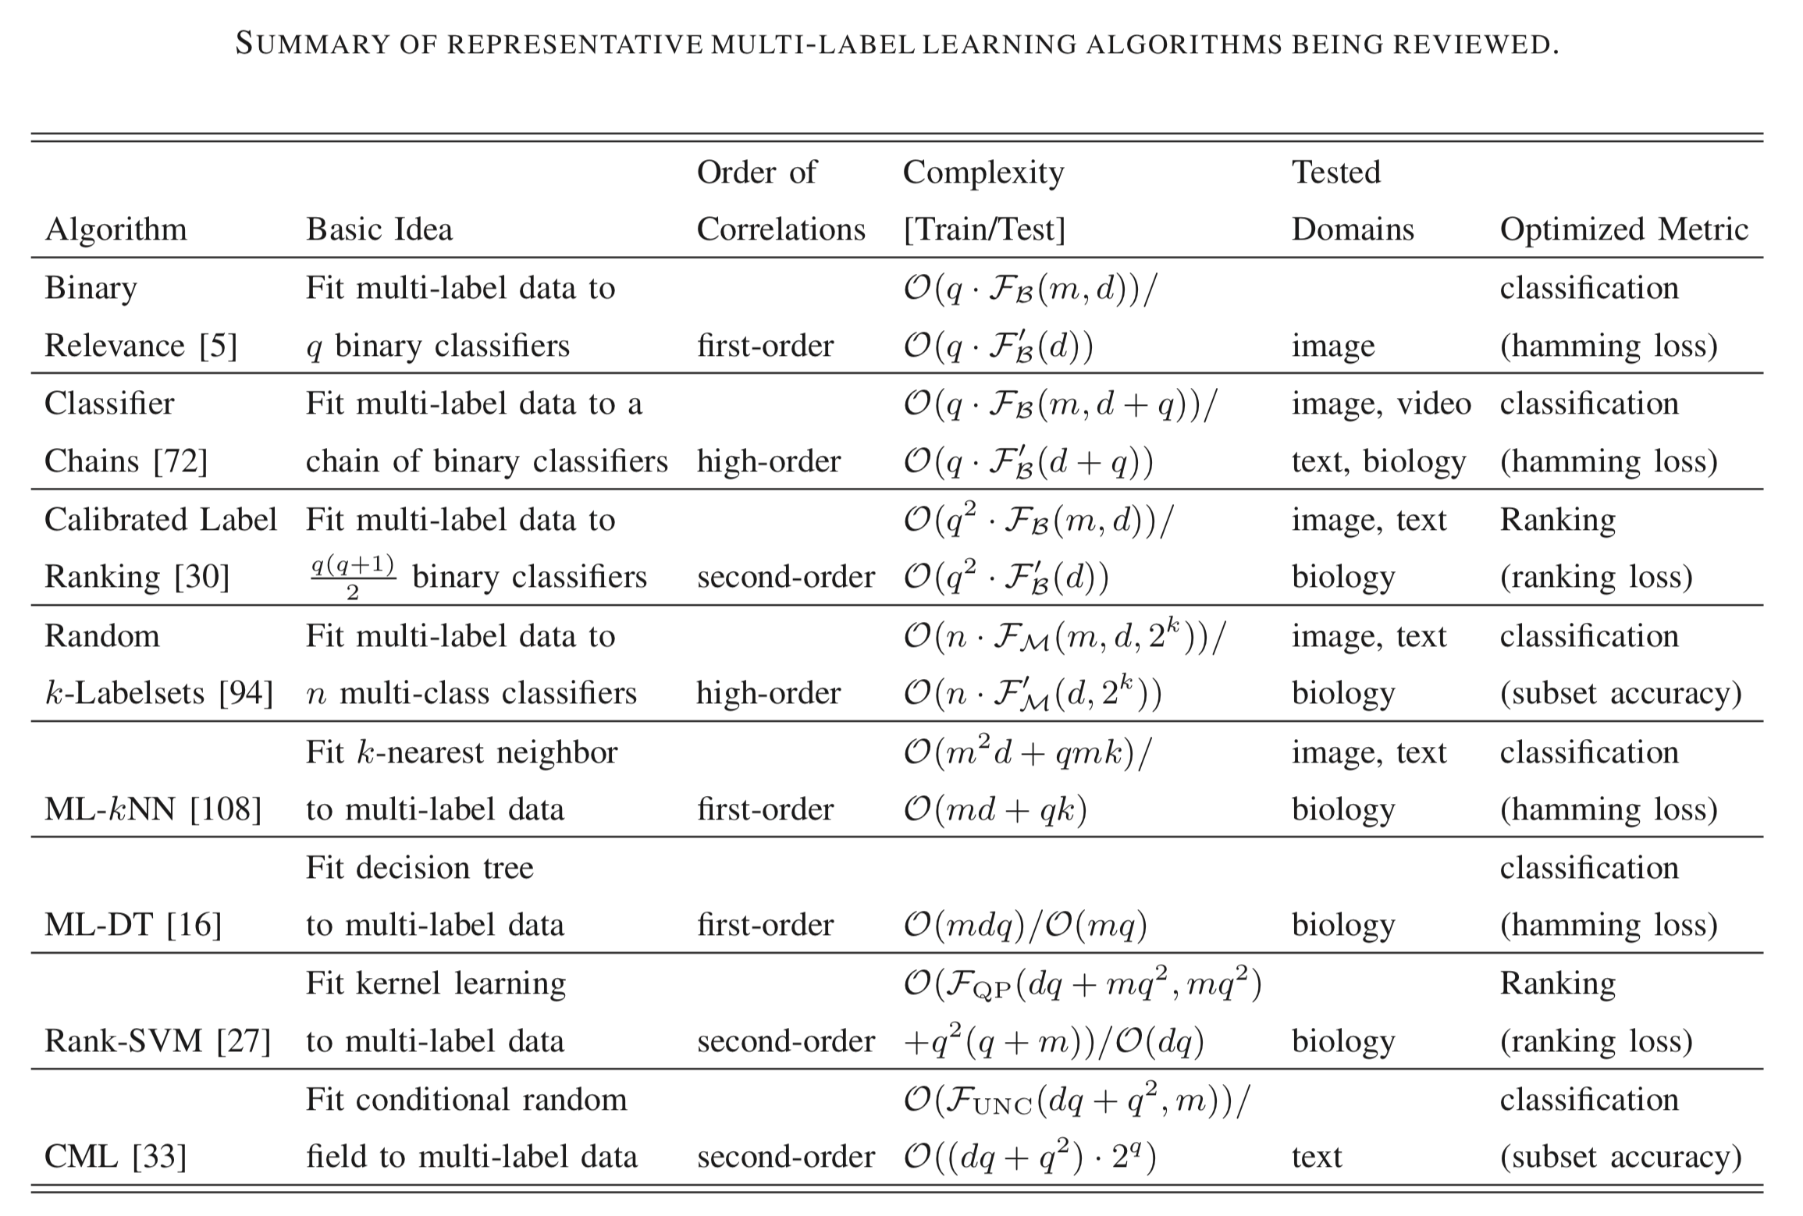

Slide 14
Preprocessing
Read
Data
Clean
Data
Tokenize to
TFIDF
Fit
Model
Make
Prediction
Convert to word2vec
by GLoVe

Slide 15
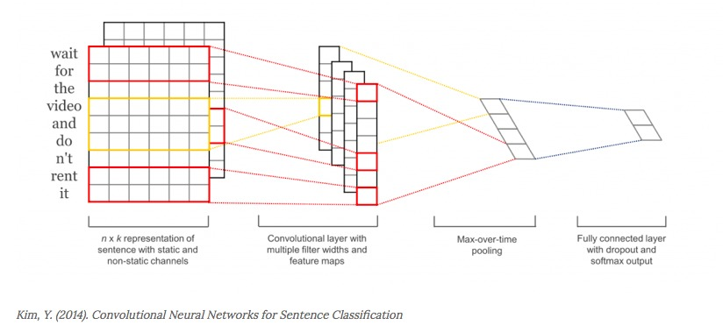
Vanilla CNN V1.0
Train for each label
Binary relevance
ROC score for CNN is: 0.502107517048
Accuracy: 0.819326941154
Conclusion: Bad Experiment

Slide 16
CNN V2.0
Train for all label
ROC: 0.9612
Used Dropout
ROC: 0.9625
Used Weight decay & Early Stopping
ROC: 0.9618

Slide 17
Latent Dirichlet Allocation (LDA)
No need for labels
Only takes 40s to train on a MacBook Air (2012 model)
Accuracy: 86% of accuracy

Slide 18
Think Different
Do we need to train model on all the data points?

Slide 19
Final Version cnn using QBC
Inspired by QBC semi-supervised learning
QBC uses a committee of models. All models are trained using the currently available labeled data.
All models vote their predictions on the Un-Labeled pool.
How to define a different CNN?

Slide 20
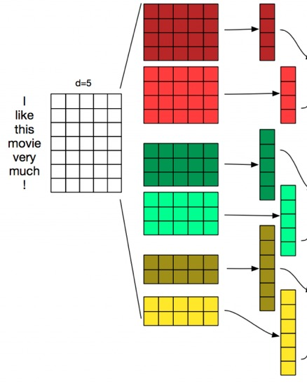
CNN final version
Different feature map

Slide 21
Experiment
Initially we have 1000 data points
Find 1000 data points with most uncertainty(conflict by committee)
For the normal CNN we just randomly add 1000 data to the labeled data pool

Slide 22
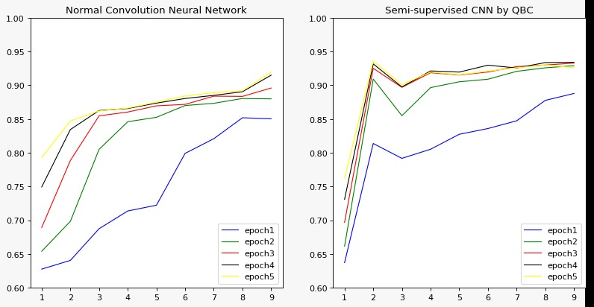
result

Slide 23
Conclusion
Model | Accuracy | AUC
Logistic Regression | 0.8784 | 0.9623
Random Forrest | 0.9148 | 0.9347
XGBoost | 0.9192 | 0.9669
CNN v1 | 0.8193 | 0.5021
CNN v2 | 0.9790 | 0.9625
LSTM | 0.9815 | 0.9731
LDA | 0.8605 | N/A
CNN final | N/A | 0.9423

Slide 24
It’s demo time

Slide 25
Thank you

